Slide 1


Virtual
Ethiopian
Ian Donald
Course
Ultrasonic
Assessment
of Recurrent
Miscarriages
14th
February
2021
Hisham Arab
Director, Ian Donald Ultrasound School,
Jeddah Chapter,
Saudi Arabia

Slide 2
Disclosure of Potential Conflict of Interest
I do not have a relationship with a commercial entity such as a pharmaceutical organization, medical device company or a communications firm

Slide 3
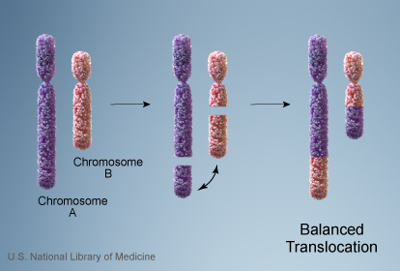
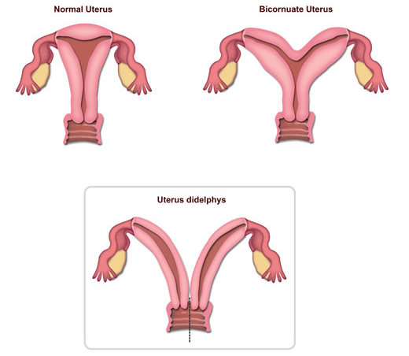
RPL Etiology
It is common to divide the associations of recurrent miscarriage into the following categories:
• Unexplained 40-50%
• Genetic 5%
• Anatomical 15%
• Immunological 15%
• Thrombophilic
• Endocrinological
• Infective
• Environmental.

Slide 4
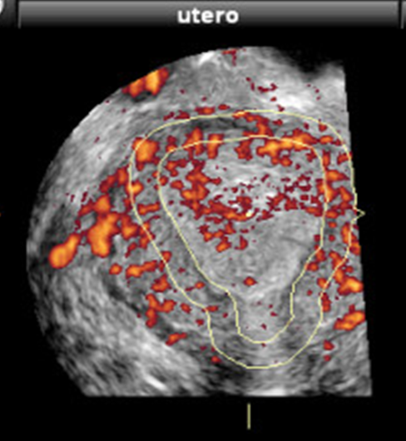
RPL Etiology
It is common to divide the associations of recurrent miscarriage into the following categories:
• Unexplained 40-50%
• Genetic 5%
• Anatomical 15%
• Immunological 15%
• Thrombophilic
• Endocrinological
• Infective
• Environmental.

Slide 5


RPL Anatomical Cause & Ultrasound Role
Cervical
Incompetence
Uterine
Malformations
Endometrial
Receptivity
3D US
3D Power Doppler

Slide 6
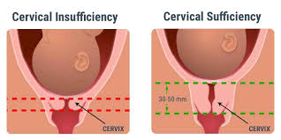
Cervical Incompetence
It is a functional or structural defect, in the absence of contractions or labor.
The incidence of cervical insufficiency is estimated to be 1% of all pregnancies and as many as 20% of mid-second trimester spontaneous pregnancy losses.
Mechanical
  previous cervical surgery or extensive trauma
Congenital
  Congenital hypoplastic cervix
  In Ehlers-Danlos syndrome or Marfan syndrome, due to the deficiency in collagen.
Unknown
  However, many women with a clinical diagnosis of cervical incompetence have normal cervical anatomy.
Infection
  The cervix is the main mechanical barrier separating the pregnancy from the vaginal bacterial flora. Many patients who have asymptomatic mid-trimester cervical dilation also have evidence of subclinical intrauterine infection.

Slide 7
Cervical Incompetence

Slide 8
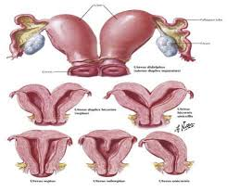
Uterine Malformation
Population | Prevalence
General | 0.1 – 3 %
Infertile | 13.3 %
Repeated Spontaneous Miscarriage* | 3 – 38 %
*Exclusively linked to Septate Uterus out of all uterine anomalies

Slide 9
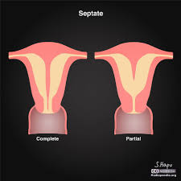
The Septate Uterus
The most common mullerian anomaly,
The one associated with the worst reproductive outcome,
  first trimester (25%) and
  second trimester (6%) losses
The one most amenable to hysteroscopic correction.
Septate should be distinguished from Arcuate and other uterine anomalies by:
  Hysteroscopy is best to assess uterine cavity
  Laparoscopy is the best to evaluate the external uterine surface

Slide 10
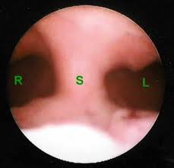
Septate Uterus
Hysteroscoy
Broad, unnotched fundus on Laparoscopy

Slide 11
However, 3D Ultrasound can give you a view like this
The sensitivity and specificity of 3D US in the detection of a septated uterus is 98.4% and 100.0%, respectively.
Fertil Steril 1996;
65(3):523–8.
Ultrasound Obstet Gynecol 2001; 18:387-400.
3D Ultrasound reported 91.6% correlation with laparoscopic findings

Slide 12
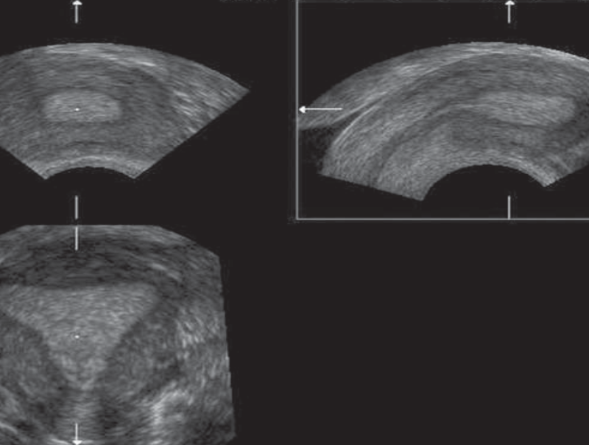
Obtaining the 3D view on TVS
Best performed during the secretory phase
Start with visualization of the uterus on 2D.
Ultrasound in a strict mid-sagittal view,
Transverse plane is used to include both uterine horns in the rendering box.
Normal Uterus

Slide 13
Transvaginal 3D multiplanar ultrasound
The volume was then obtained using a sweep angle of 90° from one side of the uterus to the other, bisecting the capture plane.
The volumes were manipulated until a satisfactory surface rendered image was obtained of the fundus and uterine cavity as well as the cervical canal.
Double cavity Uterus

Slide 14
3D surface rendered ultrasound image
arcuate uterus
bicornuate uterus
Troiano R, McCarthy S. Radiology 2004;233:19–34.

Slide 15
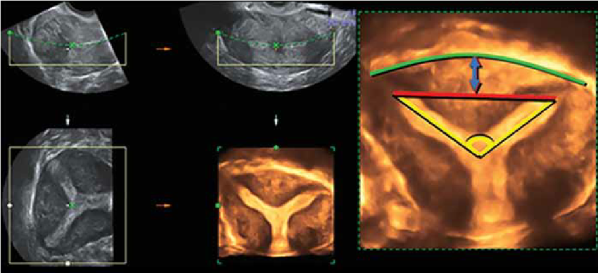
Sub-septate uterus Diagnostic Criteria on 3D
>5 mm
<4 cm
<75°
Yellow: angle between the two endometrial lines <75°.
Red: upper endometrial lining (Distance between the 2 horns <4 cm). Green: Outer bounds of the uterine fundus, no notch in fundus.
Blue: Distance from the endometrial lining to the uterine fundus >5 mm.

Slide 16
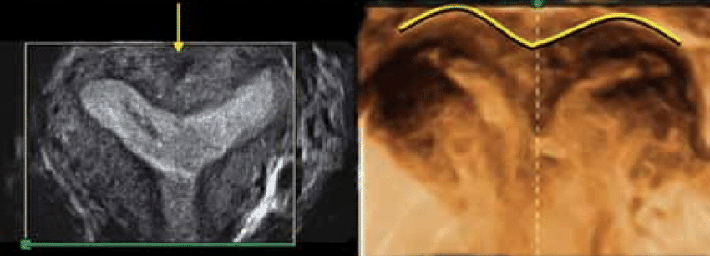

Diff. Dx: 1) Bicornuate Uterus
Yellow arrow & line: show the fundal indentation of a bicornuate uterus,
Blue angle: an angles > 75° corresponds to bicornuate uteri. Red line: upper endometrial lining with Distance between the 2 horns >4 cm):
If this line crossed the fundus or was <5 mm from it, the uterus was considered bicornuate.
Troiano R, McCarthy S. Radiology 2004;233:19–34.

Slide 17
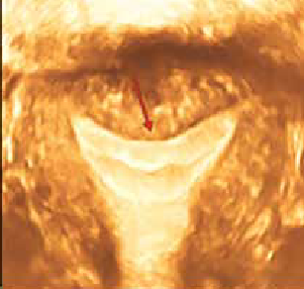
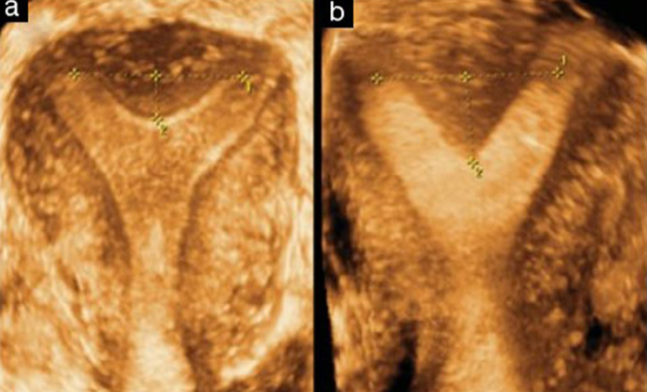
Diff. Dx: 2) Arcuate Uterus
The characteristic is the arched shape of the fundus and no fundal notch. A smooth and broad depression of the endometrial line at the fundus, the depth of indentation is usually considered to be <1 cm.
Obstet Gynecol 2001;98:1099–103.

Slide 18
3D TVS is becoming the Gold Standard for Septate Diagnosis
42 cases all accurately diagnosed with 3D Ultrasound
mimicking Hysteroscopy/Laparoscopy gold standard approach
with 100% Sensitivity and Specificity
Conclusion
Pre-op assessment with 3D ultrasound can be done safely without need for laparoscopic confirmation or guidance.
The Egyptian Journal of Radiology and Nuclear Medicine, 2014

Slide 19
3D TVS is part of RPL work up
Fertil Steril 2009
Conclusion(s): Volume transvaginal ultrasound appears to be extremely accurate for the diagnosis and classification of congenital uterine anomalies and may conveniently become the only mandatory step in the assessment of the uterine cavity in patients with a history of recurrent miscarriage.

Slide 20
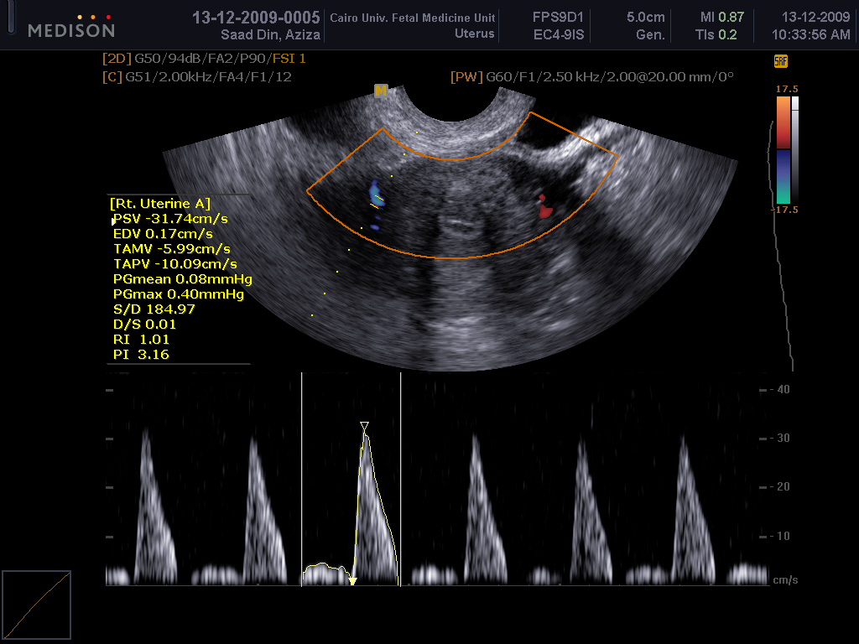
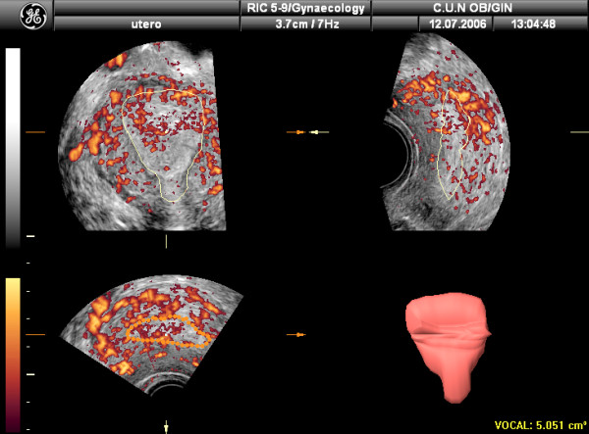
More Importantly
RPL is a manifistation of Vascular Dysfunction of the Endometrium

Slide 21
Endometrial Receptivity
Factors affecting
neo- microvascularization:
age,
aspirin,
omega-3,
sildenafil,
menstrual days,
smoking,
serum testosterone,
anti-Müllerian hormone
Endometrial vasculature is considered to be important in the early endometrial response to blastocyst implantation, and vascular changes can influence uterine receptivity.
Endometrial neomicrovascularization significantly increases during the follicular and early luteal phases, suggesting that endometrial vascular changes affect endometrial growth and implantation
An advantage of power Doppler ultrasound is extreme sensitivity to low or slow vascular flow, which can identify overlapping vessels. This technique displays total flow in a confined area, providing images similar to angiography

Slide 22
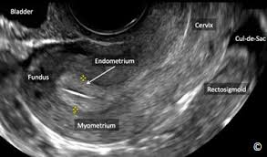
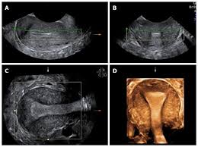
Endometrial Volume & Pregnancy Prediction
In (ART), the predictive value of endometrial thickness for pregnancy is still controversial.
3D provides accurate contrast between the myometrium and endometrium for distinguishing these features and calculating the endometrial volume .
The accepted volume for endometrial receptivity has a threshold of 3.2 mL for establishing a pregnancy, with a negative predictive value of 96%.

Slide 23
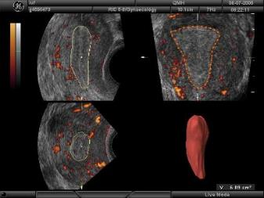
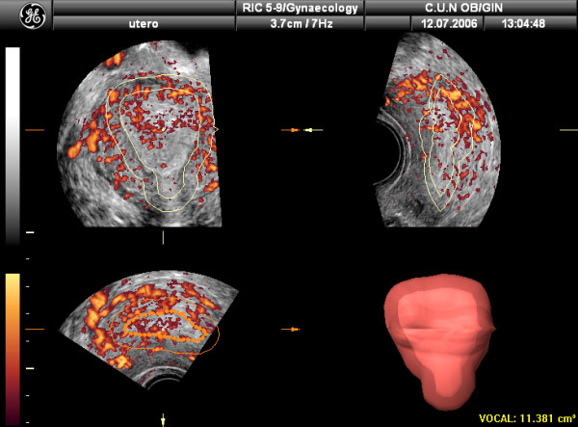
Assessment of the sub-endometrial region
A total of 12 endometrial slices were obtained outlining the endometrium at the myo-endometrial junction from fundus to internal os.
by using the "shell" facility.
In this case 5 mm from the endometrial border has been chosen.
Taiwanese Journal of Obstetrics & Gynecology 53 (2014)

Slide 24
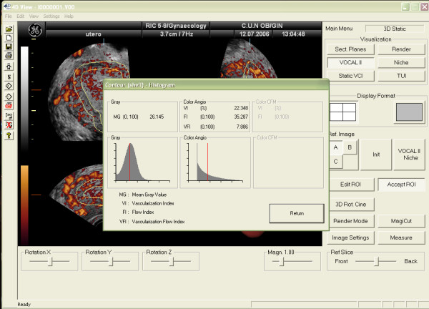
Calculating Subendometrial shell volume and blood flow
Built-in VOCAL (Virtual Organ Computer- Aided Analysis) software for 3D power Doppler histograms were used to measure blood flow indices.
Three vascular indices calculated automatically by 3D PD-US were
Vascularization index (VI)
Flow index (FI),
Vascularization flow index (VFI).
These VI, FI and VFI indices refers to the shell area, and not the endometrium

Slide 25
Findings
Uterine artery fluxometry and subendometrial blood flow as single evaluation parameters, or in combination as a ratio show a clear continuous mechanism that enables endometrium to become receptive to a healthy embryo, and reduce miscarriage
Sub-endometrial blood flow Indices | Finding
Mean uterine artery pulsatility index (MUAPI) | 2.319±0.5309 than in control group(1.689±0.4832) (p value 0.000).
Vascularity index(VI) | (2.726±3.0482)than in control group (2.29±3.03) (p value 0.29).
Vascular Flow index(VFI) | 1.20±1.11than in case group(0.71±0.65) (p value 0.048).
flow index (FI) | 23.975±4.1716) than in case group(19.138±6.9013) (p value 0.002).
Reproductive Biology and Endocrinology, 2019

Slide 26
Role of Ultrasound in RPL
2D US to assess Cervix
3D US to assess Endometrial Cavity
3D Power Doppler US to assess Endometrial Receptivity

Slide 27
Conclusions
Routine Ultrasound Examination is a key tool for the primary assessment of all women suffered Recurrent Pregnancy Loss.
Ultrasound Examination alone may reveals 30 – 50 % of the possible etiologies of RPL.
3D TVS is becoming the gold standard to diagnose Uterine septum that lead to RPL.
Compared to Surgical approach US is non-invasive, readily available, reproducible, and not so expensive.

Slide 28


